Slide 1
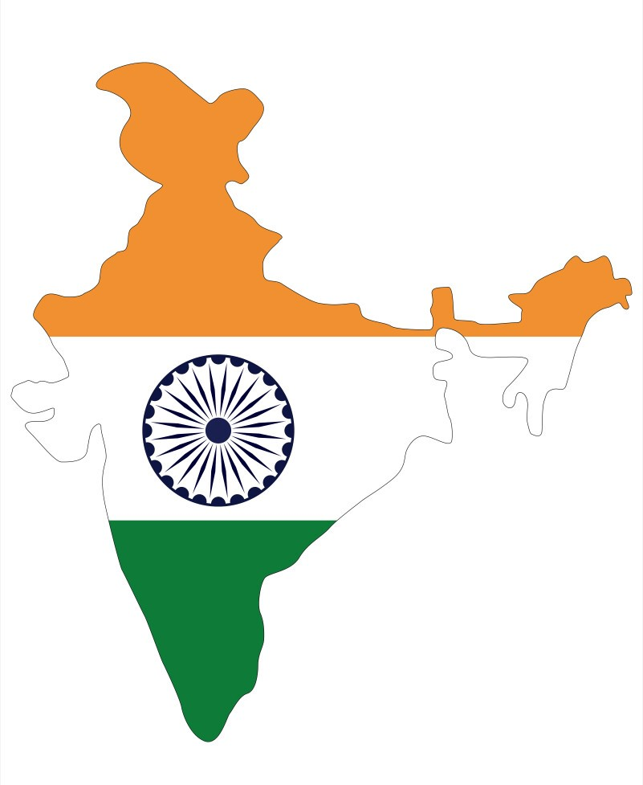

AtliQ Media Lok Sabha Political Analysis
View in Power BI
SWETHA C S

Slide 2
Home
ATLIQ MEDIA
AtliQ Media is a private media company and wants to telecast a show on lok sabha elections 2024 in India.
They are not interested in having a debate like other channels
To stand out from others they want to present insights from 2014 and 2019 elections.
Notes:
image
No alt text provided
actionButton
No alt text provided
actionButton
No alt text provided
actionButton
No alt text provided
actionButton
No alt text provided
actionButton
No alt text provided
actionButton
No alt text provided
textbox
No alt text provided

Slide 3
Home
ATLIQ MEDIA
The company has reached out for help from data team to conduct political analysis and present insights.
The data source is Election Commission of India Website.
The team has planned out primary and secondary analysis which vastly covers the major insights.
Also the team is free enough to provide additional insights too.
Notes:
image
No alt text provided
actionButton
No alt text provided
actionButton
No alt text provided
actionButton
No alt text provided
actionButton
No alt text provided
actionButton
No alt text provided
actionButton
No alt text provided
textbox
No alt text provided

Slide 4
Home
ATLIQ MEDIA
Lok Sabha elections help in forming central government of India.
It is held every five years to elect members of lower house of the parliament.
Each election sees a multitude of political parties and independent candidates vying for 543 seats across various constituencies.
The party or the coalition with the majority of seats forms the government.
Notes:
image
No alt text provided
actionButton
No alt text provided
actionButton
No alt text provided
actionButton
No alt text provided
actionButton
No alt text provided
actionButton
No alt text provided
actionButton
No alt text provided
textbox
No alt text provided

Slide 5
Home
ATLIQ MEDIA
DATA IMPORT
3 csv files were imported as data source.
HTML tables were imported for secondary analysis.
DATA CLEANING AND TRANSFORMATIONS
Identified and resolved identical constituency names
Corrected spelling errors
Filled missing values with appropriate data
Removed duplicates
Maintained consistency throughout the data
Notes:
image
No alt text provided
actionButton
No alt text provided
actionButton
No alt text provided
actionButton
No alt text provided
actionButton
No alt text provided
actionButton
No alt text provided
actionButton
No alt text provided
textbox
No alt text provided

Slide 6
Home
ATLIQ MEDIA
DATA ANALYSIS
Conducted descriptive and statistical analysis to uncover insights.
DATA VISUALIZATION
Various analysis of candidates, parties, voter turn outs were made.
Key metrics were provided.
Interactivity is facilitated.
Extensive insights are uncovered.
Notes:
image
No alt text provided
actionButton
No alt text provided
actionButton
No alt text provided
actionButton
No alt text provided
actionButton
No alt text provided
actionButton
No alt text provided
actionButton
No alt text provided
textbox
No alt text provided

Slide 7
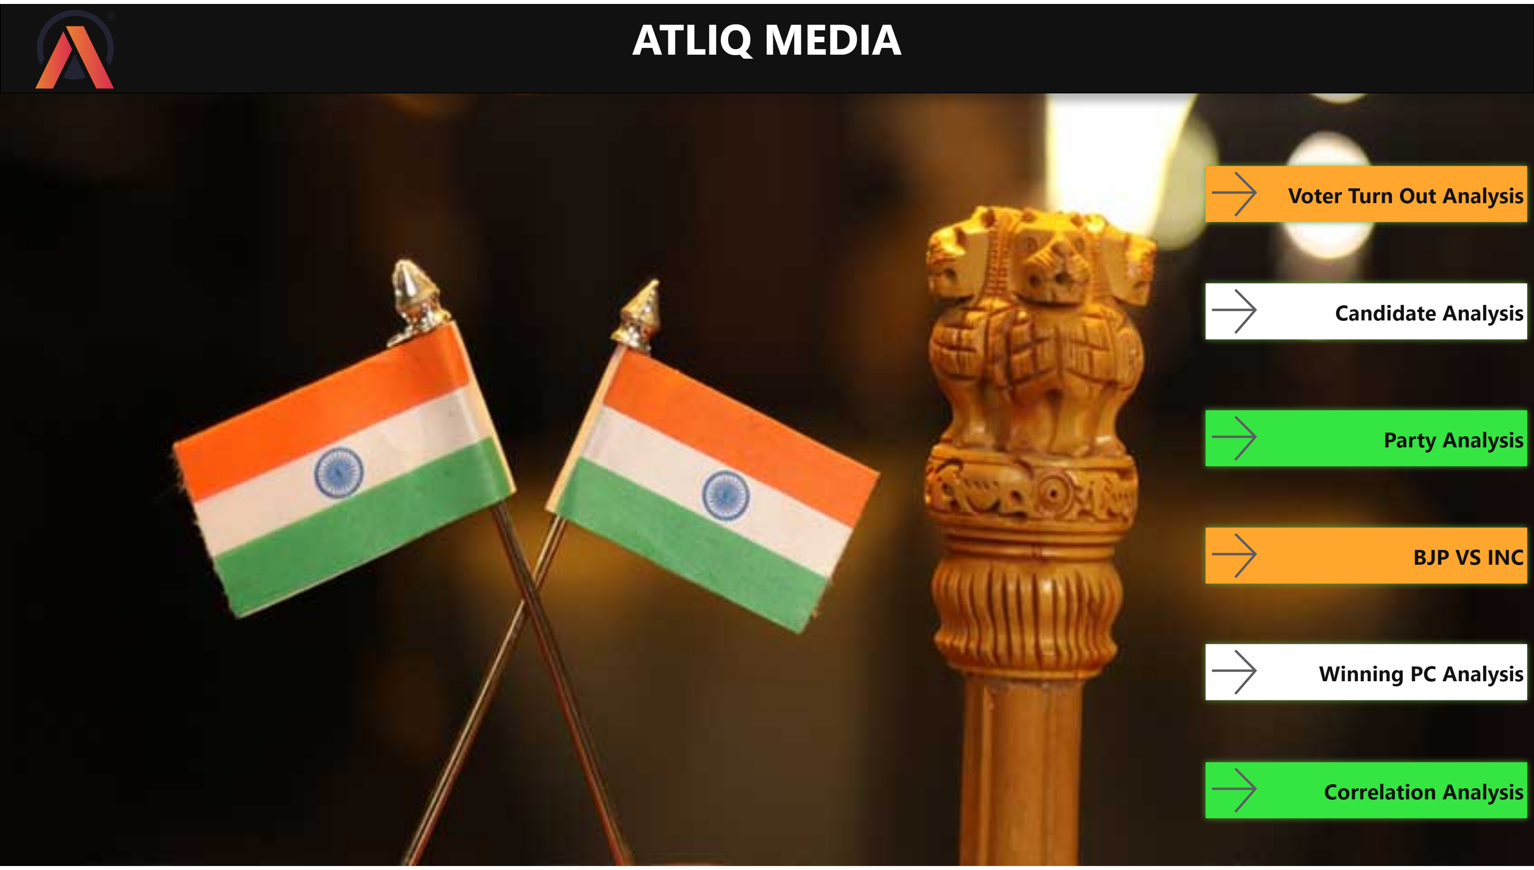
Home
Notes:
image
No alt text provided
actionButton
No alt text provided
actionButton
No alt text provided
actionButton
No alt text provided
actionButton
No alt text provided
actionButton
No alt text provided
actionButton
No alt text provided
textbox
No alt text provided

Slide 8
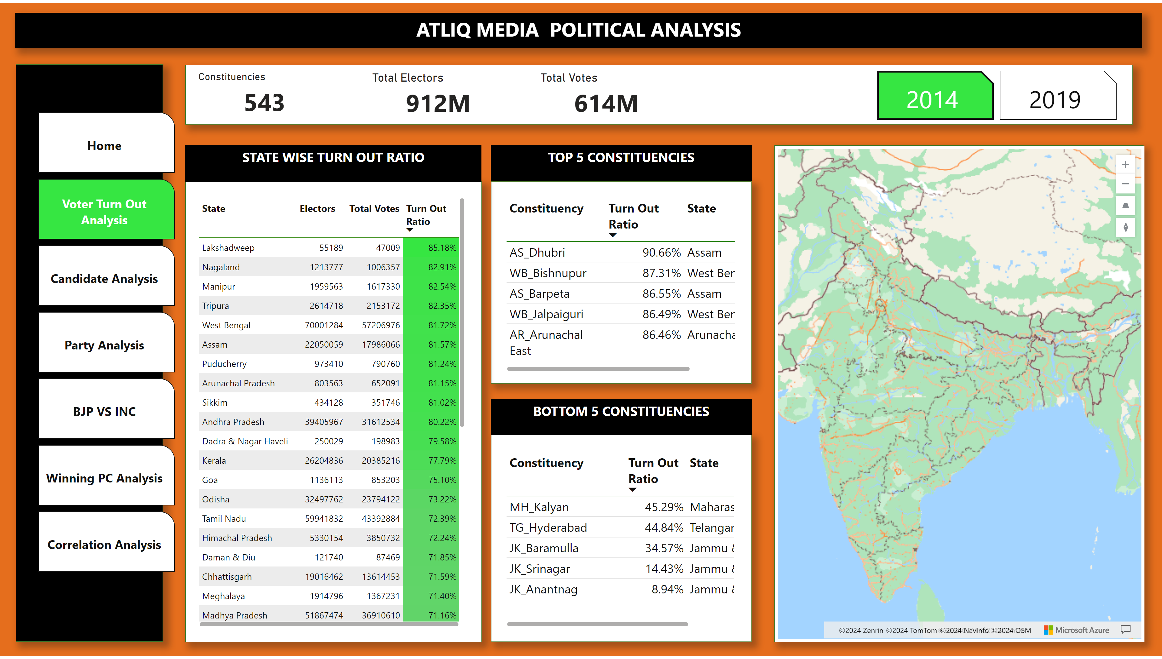
Voter Turn Out Analysis
Notes:
pageNavigator
No alt text provided
textbox
No alt text provided
shape
No alt text provided
shape
No alt text provided
shape
No alt text provided
clusteredBarChart
No alt text provided
clusteredBarChart
No alt text provided
shape
No alt text provided
tableEx
No alt text provided
tableEx
No alt text provided
tableEx
No alt text provided
azureMap
No alt text provided
shape
No alt text provided
textbox
No alt text provided
textbox
No alt text provided
textbox
No alt text provided
shape
No alt text provided
bookmarkNavigator
No alt text provided
19 state turn out tbl
No alt text provided
19 top turn out tbl
No alt text provided
19 bottom turn out tbl
No alt text provided
shape
No alt text provided
card
No alt text provided
Constituencies
No alt text provided
card
No alt text provided
Total Electors
No alt text provided
card
No alt text provided
Total Votes
No alt text provided

Slide 9
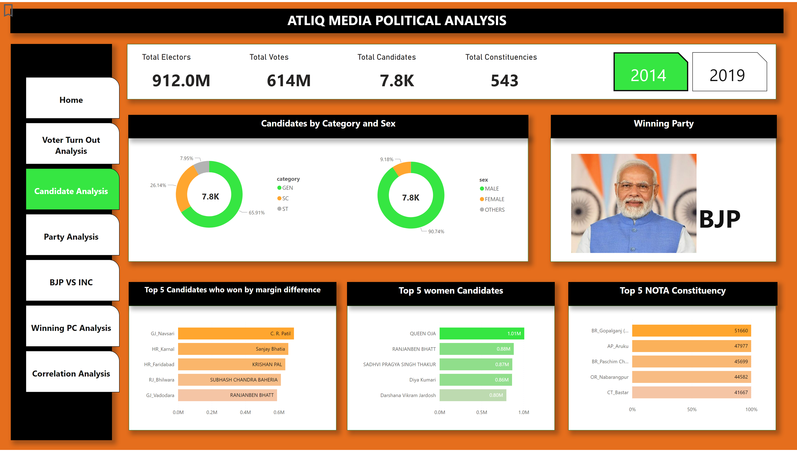
Candidate Analysis
Notes:
card
No alt text provided
pageNavigator
No alt text provided
card
No alt text provided
card
No alt text provided
card
No alt text provided
textbox
No alt text provided
textbox
No alt text provided
card
No alt text provided
shape
No alt text provided
textbox
No alt text provided
shape
No alt text provided
card
No alt text provided
shape
No alt text provided
shape
No alt text provided
shape
No alt text provided
donutChart
No alt text provided
donutChart
No alt text provided
barChart
No alt text provided
Winning Party
No alt text provided
clusteredBarChart
No alt text provided
actionButton
No alt text provided
bookmarkNavigator
No alt text provided
shape
No alt text provided
textbox
No alt text provided
donutChart
No alt text provided
donutChart
No alt text provided
2019 candidate card
No alt text provided
2019 cand Card
No alt text provided
Total Electors
No alt text provided
Total Votes
No alt text provided
Total Candidates
No alt text provided
Total Constituencies
No alt text provided
clusteredBarChart
No alt text provided
textbox
No alt text provided
clusteredBarChart
No alt text provided
shape
No alt text provided
textbox
No alt text provided
hundredPercentStackedBarChart
No alt text provided
hundredPercentStackedBarChart
No alt text provided

Slide 10
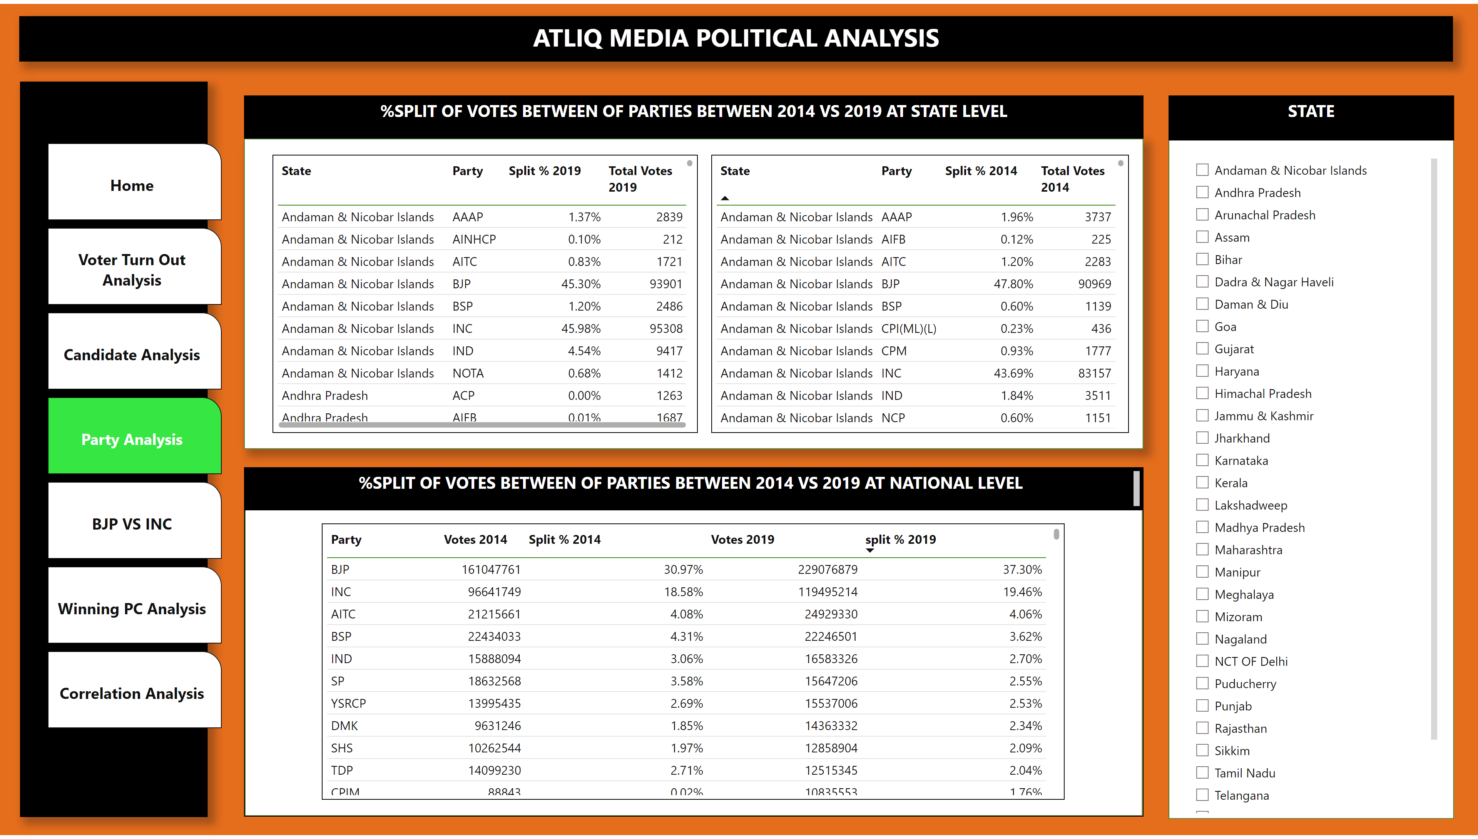
Party Analysis
Notes:
pageNavigator
No alt text provided
textbox
No alt text provided
shape
No alt text provided
textbox
No alt text provided
textbox
No alt text provided
shape
No alt text provided
shape
No alt text provided
shape
No alt text provided
slicer
No alt text provided
textbox
No alt text provided
tableEx
No alt text provided
tableEx
No alt text provided
tableEx
No alt text provided

Slide 11
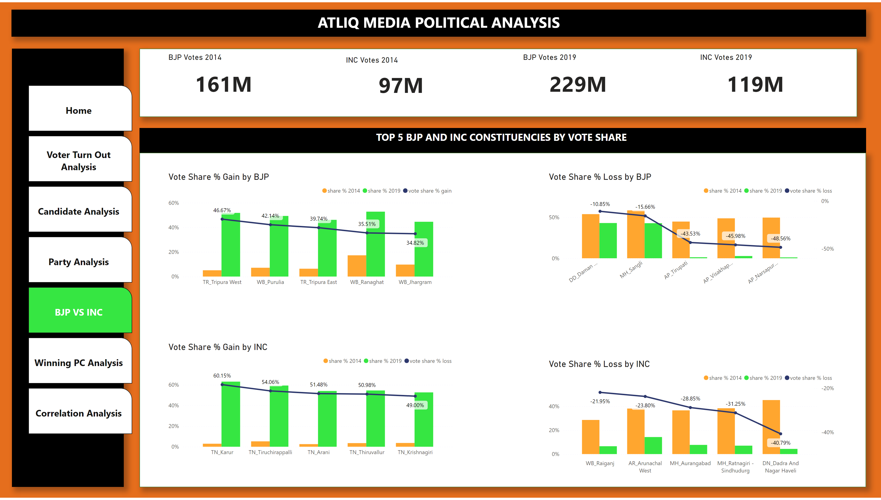
BJP VS INC
Notes:
pageNavigator
No alt text provided
textbox
No alt text provided
shape
No alt text provided
textbox
No alt text provided
Vote Share % Gain by BJP
No alt text provided
Vote Share % Loss by BJP
No alt text provided
shape
No alt text provided
Vote Share % Loss by INC
No alt text provided
Vote Share % Gain by INC
No alt text provided
BJP Votes 2014
No alt text provided
BJP Votes 2019
No alt text provided
INC Votes 2014
No alt text provided
INC Votes 2019
No alt text provided
shape
No alt text provided

Slide 12
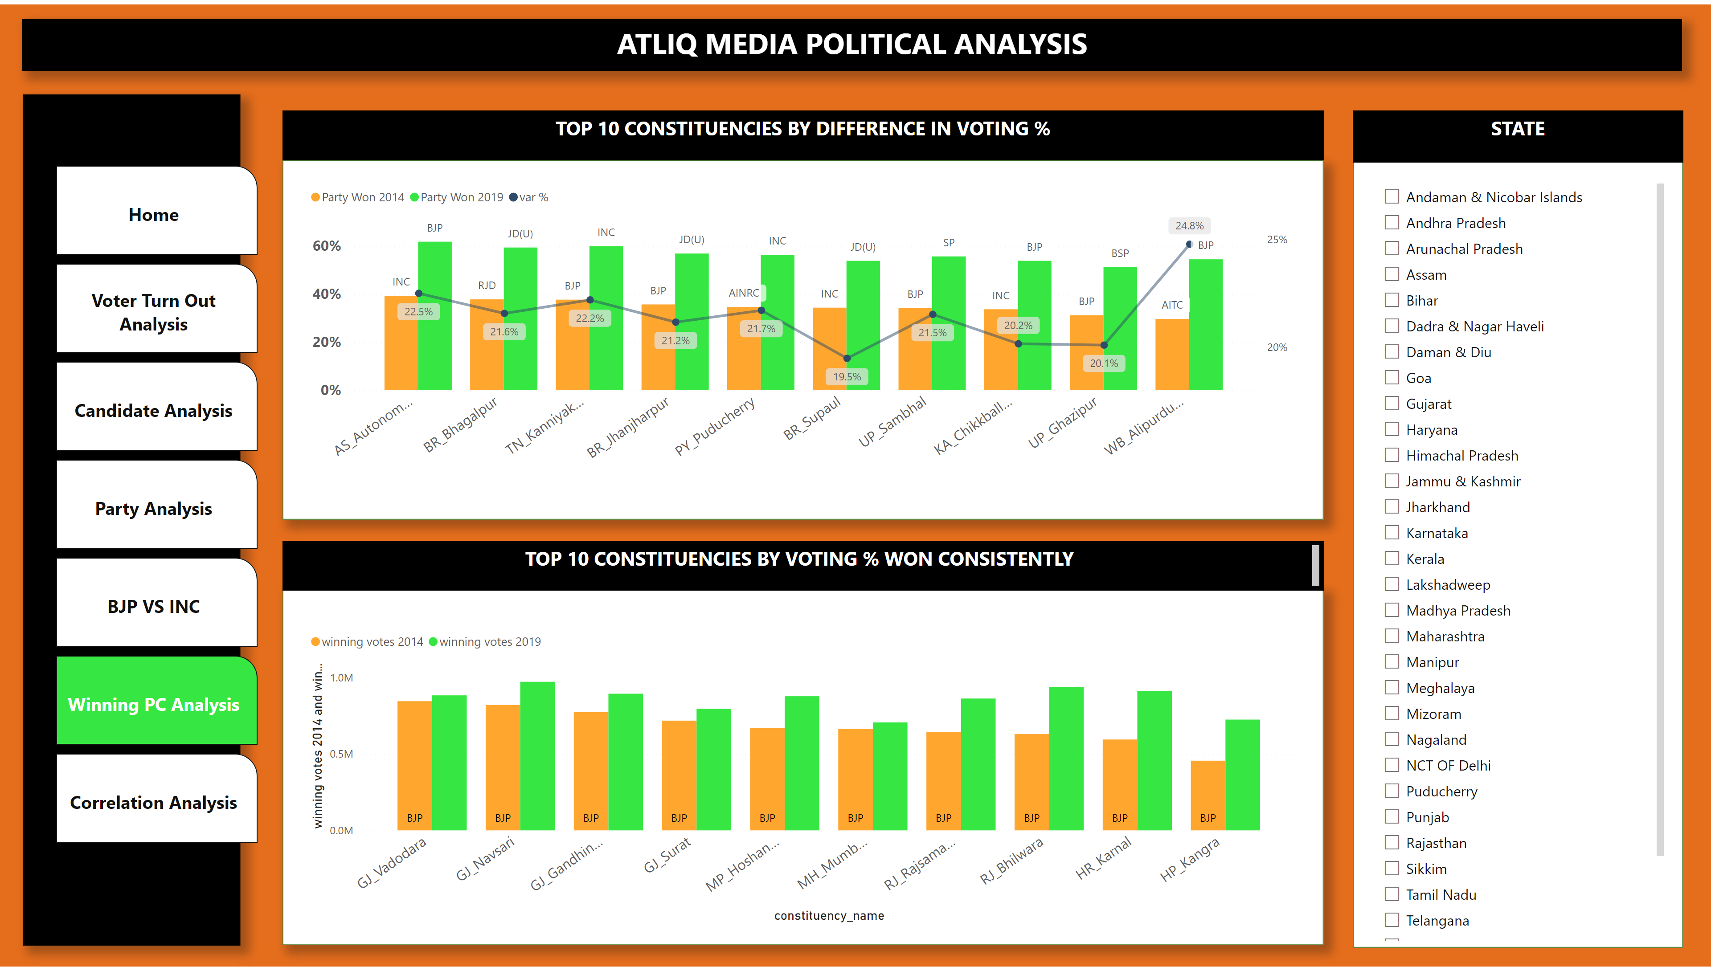
Winning PC Analysis
Notes:
pageNavigator
No alt text provided
textbox
No alt text provided
shape
No alt text provided
textbox
No alt text provided
textbox
No alt text provided
shape
No alt text provided
shape
No alt text provided
clusteredColumnChart
No alt text provided
lineClusteredColumnComboChart
No alt text provided
shape
No alt text provided
slicer
No alt text provided
textbox
No alt text provided

Slide 13
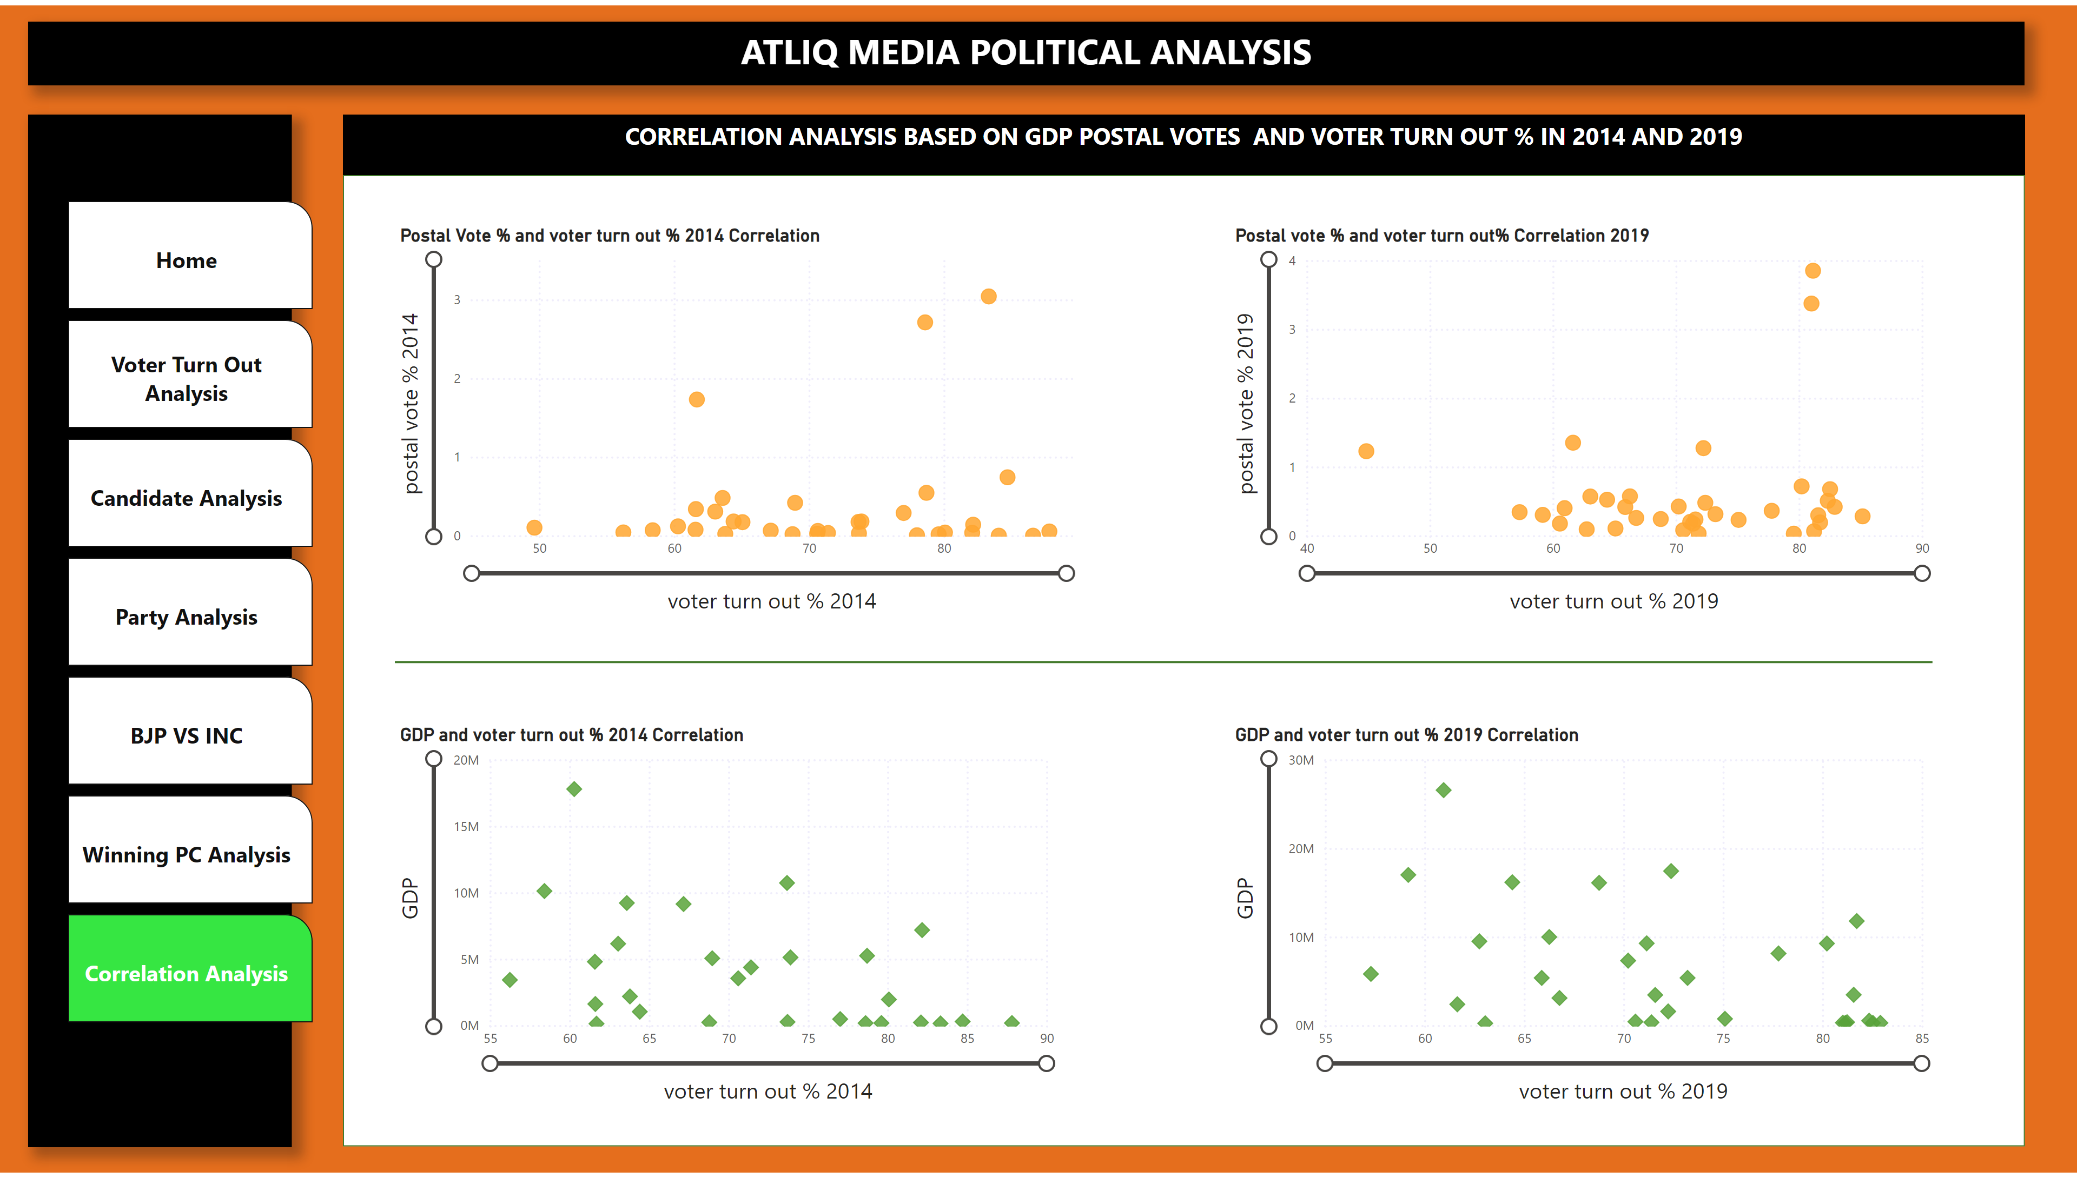
Correlation Analysis
Notes:
pageNavigator
No alt text provided
textbox
No alt text provided
shape
No alt text provided
textbox
No alt text provided
shape
No alt text provided
Postal Vote % and voter turn out % 2014 Correlation
No alt text provided
Postal vote correlation 2019
No alt text provided
Postal vote % and voter turn out% Correlation 2019
No alt text provided
GDP and voter turn out % 2019 Correlation
No alt text provided
GDP and voter turn out % 2014 Correlation
No alt text provided
shape
No alt text provided

Slide 14
Home
ATLIQ MEDIA
INSIGHTS
BJP is the majority won party in both elections.
Female candidates are only 8.22% and 9.18% in 2014 and 2019 resp.
Constituency having highest NOTA Votes are Nilgiris and Gopalgunj(SC) in 2014 and 2019 resp.
Sumitra Mahajan and Queen Oja are the female candidates having highest votes around 0.85 M and 1M in 2014 and 2019 resp.
All the top 10 constituencies by voting% who won consistently has elected BJP.
Nagaland and Lakshadweep have highest voter turn out ratio.
Notes:
image
No alt text provided
actionButton
No alt text provided
actionButton
No alt text provided
actionButton
No alt text provided
actionButton
No alt text provided
actionButton
No alt text provided
actionButton
No alt text provided
textbox
No alt text provided

Slide 15
Home
ATLIQ MEDIA
RECOMMENDATIONS
Awareness programs need to be conducted in the regions having low voter turn out ratio.
Female candidate participation needs to be encouraged.
Educate the electors about the postal voting facility.
More convenient voting options must be planned for senior citizens, new mothers, pregnant women and disabled voters.
Candidates must be reassessed to avoid greater NOTA.
Notes:
image
No alt text provided
actionButton
No alt text provided
actionButton
No alt text provided
actionButton
No alt text provided
actionButton
No alt text provided
actionButton
No alt text provided
actionButton
No alt text provided
textbox
No alt text provided

Slide 16
Home
ATLIQ MEDIA
RECOMMENDATIONS
Educate the importance of voting and encourage the first time voters to participate.
Increase the polling booths to avoid the chaos.
Provide assistance to the voters to get the necessary documents beforehand to be eligible for voting.
Notes:
image
No alt text provided
actionButton
No alt text provided
actionButton
No alt text provided
actionButton
No alt text provided
actionButton
No alt text provided
actionButton
No alt text provided
actionButton
No alt text provided
textbox
No alt text provided

